Slide 1

Introduction to Rudhall Class
Miss Baugh
Teaching Assistants: Mrs Swift and Miss Brown

Slide 2
Contents
01
Aims of Year 5
Classroom Routines
Behaviour Expectations
School Uniform
The Curriculum
Assessment
Homework
How can you help?
02
03
04
05
06
07
08

Slide 3
01
Aims of
Year 5

Slide 4
Year 5 Aims
Build on the skills and knowledge learnt in KS1 and lower KS2.
Preparing for Year 6 expectations.
Continuing to develop independence, confidence, maturity and initiative.
Recognising that mistakes help us to improve and building resilience.

Slide 5

02
Classroom
Routines

Slide 6
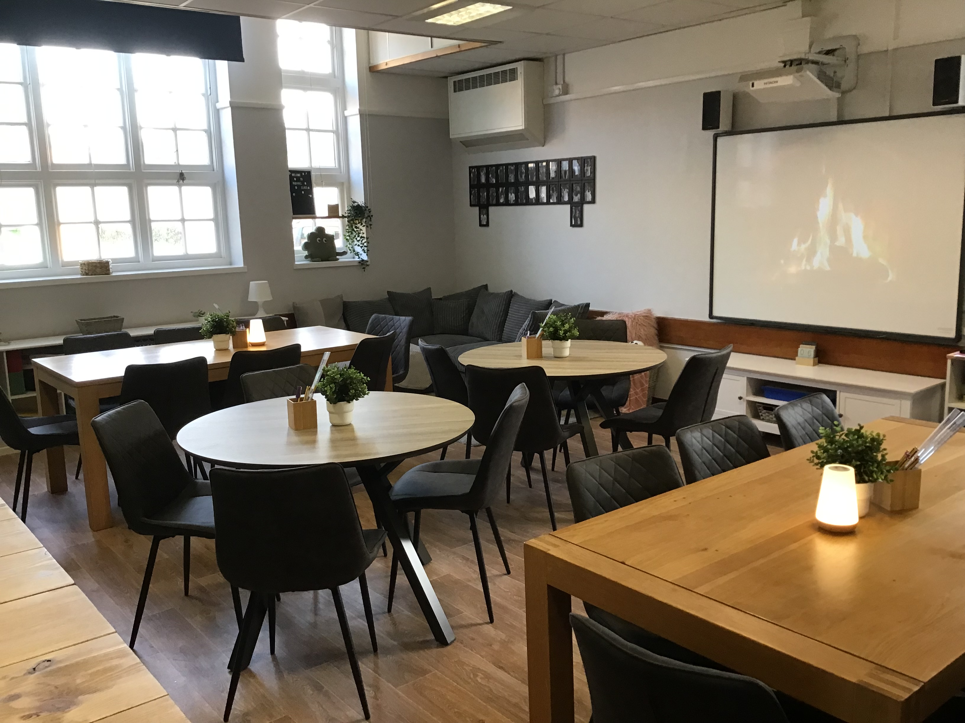
Therapeutic Classroom
Last summer, Rudhall class received an exciting makeover. The classroom has been designed by TPC, experts in children’s mental health and wellbeing, to create a safe, calm and inclusive environment that is conducive to learning.
Please follow the link for more information Therapeutic Classrooms - TPC Therapy

Slide 7
Classroom Routines
At the start of the day the children are responsible for:
Handing in any notes/letters.
Bags and coats on their pegs.
Lunchboxes have a place by their pegs.
Putting book bags in the basket in the classroom.
Water bottles are kept in the classroom (containing water only please).

Slide 8
Registration – 8:45
Breaktime – 10:20 Please consider sending in a healthy snack of fruit or vegetables for your child.
Lunchtime - 12:10
School finishes – 15:15
PE days: This term are Monday and Friday.

Slide 9
03
Behaviour expectations

Slide 10
Behaviour expectations
‘Be ready, Be respectful, Be safe’
01.
02.
03.
School behaviour policy
Class Charter
House points
04.
05.
06.
Star of the week
Champion celebration
Always try your best!

Slide 11
04
School Uniform

Slide 12
School Uniform
Please ensure all uniform is clearly labelled.
Indoor PE | T-shirt – short-sleeved in white, with school logo. Shorts – plain, in burgundy. For indoor PE children will require plimsolls or go barefoot.
Outdoor PE | T-shirt and shorts as above and socks. Trainers. Black, grey or navy track suits, sweat shirt or similar for cold weather.
Uniform | Maroon sweatshirt /cardigan with the School logo. White blouse or white ‘aertex’ short-sleeve shirt with School logo. Grey skirt, shorts or trousers. White or grey socks or black, maroon or grey tights. Black shoes (no boots or sandals). Summer option – red and white checked dress

Slide 13
05
The Curriculum

Slide 14
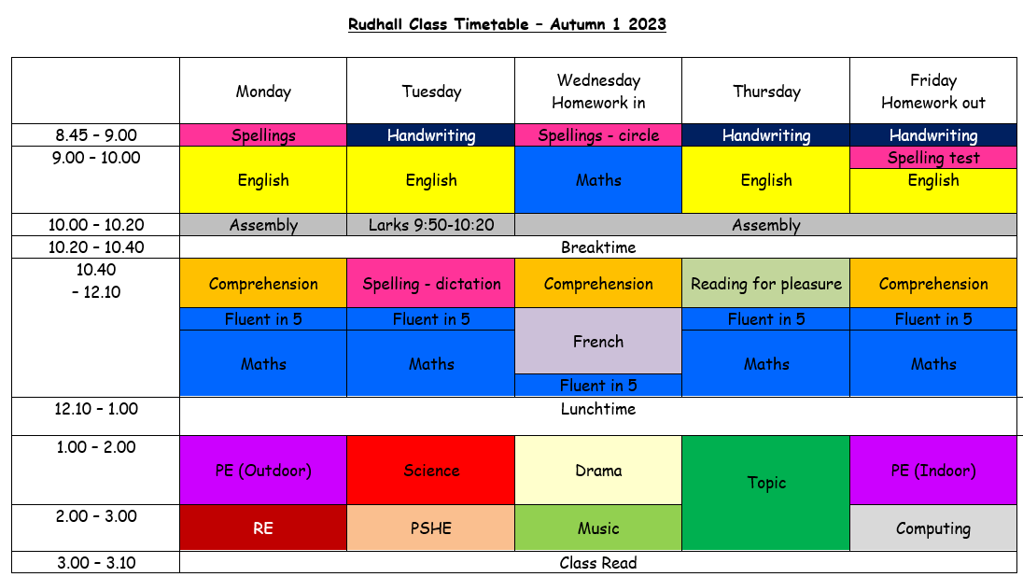
On Wednesdays, Drama will be taught by Mrs O’Neill and Music by Mrs Abbott.

Slide 15
The key skills of progression
An overriding topic for each half term which covers the progression of key skills addressed in the National Curriculum.
Cross-Curricular links within the topic to cover the foundation subjects such as DT, Art, Computing, History and Geography.
Autumn 1 – To infinity and beyond!
Autumn 2 – Walk like an Egyptian
Spring 1 – Raging rivers
Spring 2 – Crime and punishment
Summer 1 – Circle of life
Summer 2 – Being human

Slide 16
Supportive small group work
Throughout your child's time in Rudhall class, the opportunity may arise for them to take part in small group work to support their learning in different areas of the curriculum or with their social development.
Sessions are created on a 6 weekly rotation and needs based.

Slide 17
06
Assessment

Slide 18
Assessment
There are no statutory assessments/tests in Year 5.
Assessment for Learning: children are regularly assessed throughout their learning (tracking sheets, written assessments when relevant, feedback (verbal, live marking and written) and questioning).
Weekly spelling tests.
Children are encouraged to be involved in assessing their own learning through a variety of self assessment opportunities to inspire ownership of their learning and develop a growth mindset.

Slide 19
07
Homework

Slide 20
Homework
Reading
Spellings
MyMaths
Topic Task
4 times a week, reading records checked weekly.
Updated on Edshed weekly, tested on a Friday.
1-3 tasks set weekly inline with current learning in class.
1 task to be completed weekly, a chance to be creative!
Homework is due in on a Wednesday and will be returned no later than Friday.
The onus is on the child to complete their homework, an opportunity to increase their independence ahead of Year 6 and transition into Secondary School.

Slide 21
08
How can you help?

Slide 22

How can you help?
Support your child to read as much as possible and develop reading for pleasure.
Encourage your child to complete their homework and practice their spellings at home.
Promote online safety.

