Slide 1
Welcome to Oxenhall class
Year 4
Mrs Caligari (Mon, Tues and Weds)
& Mr Pascoe (Thurs and Fri)
Learning support
Mrs Carmichael

Slide 2
Key Points
Aims of Year 4
What’s different?
Classroom Routines
Behaviour Expectations
Uniform & Equipment
The Curriculum
Homework
Partners together – How can you help?

Slide 3
Aims of Year 4
To enjoy school and develop positive attitudes to learning
To build on previous learning, but also provide a fresh start if required
To foster growing independence, both for their own learning and responsibility for their belongings
For each child to reach their full potential
To strengthen the strong foundation, created in Year 3, ready for the rigours of Upper Key Stage 2, through a deeper focus on verbal feedback, self-assessment and ‘real time’ marking
NB Gorsley Goffs has a minimal marking policy.

Slide 4
What’s different?
We aim to keep the transition from Year 3 to Year 4 as smooth as possible but as the children get older, not only are they expected to take greater responsibility for themselves, but they are also provided with greater opportunities.
In May (15-16th), we plan to take the whole class for an overnight adventure to Oaker Wood ( https://www.oakerwoodleisure.co.uk/ ), for an age appropriate opportunity to challenge themselves and develop essential group skills. More information will follow shortly.

Slide 5
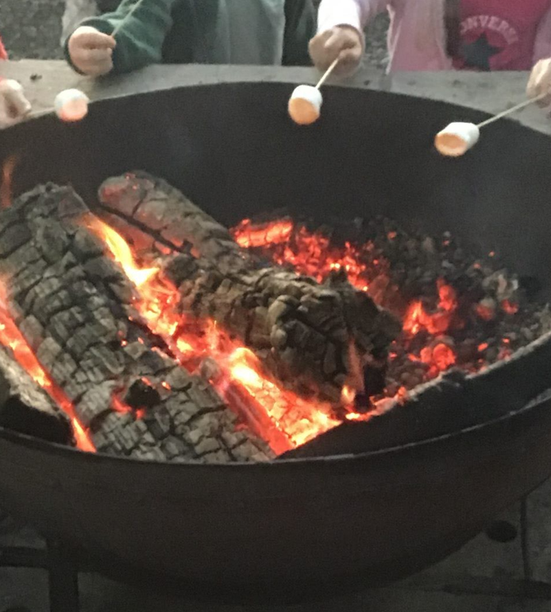
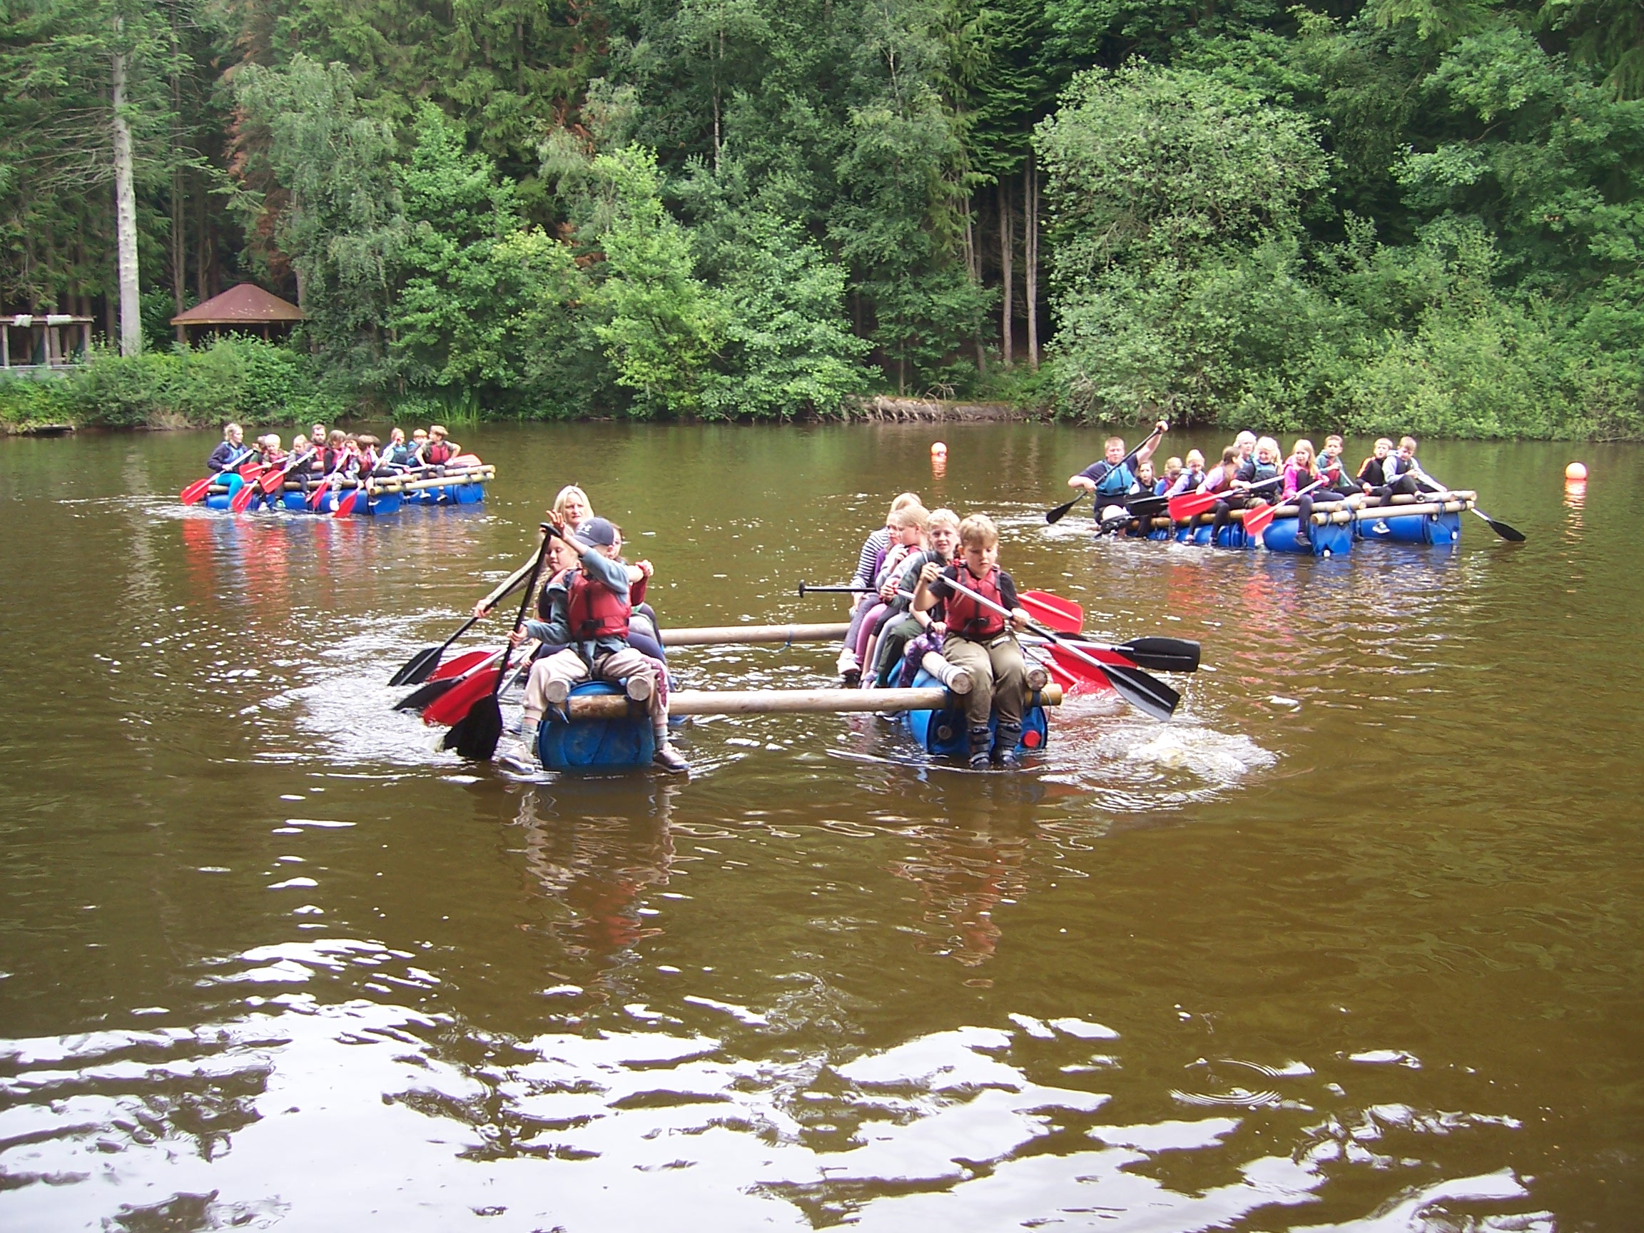
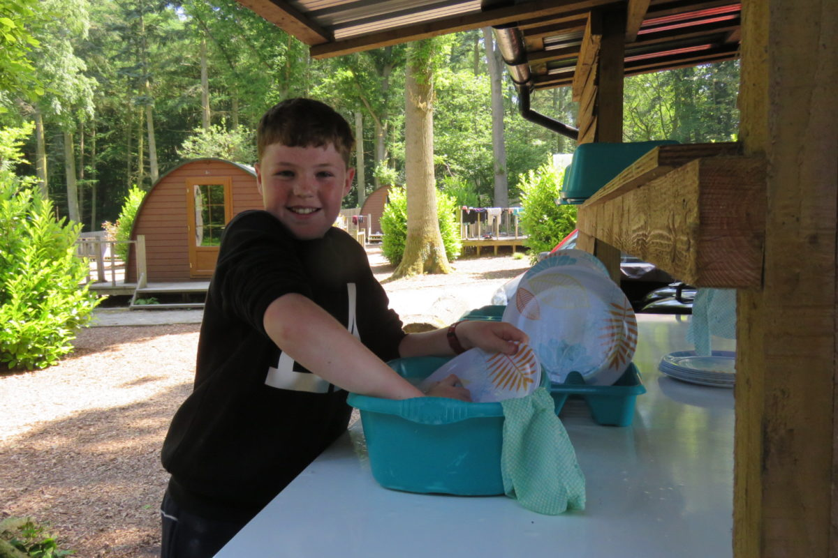
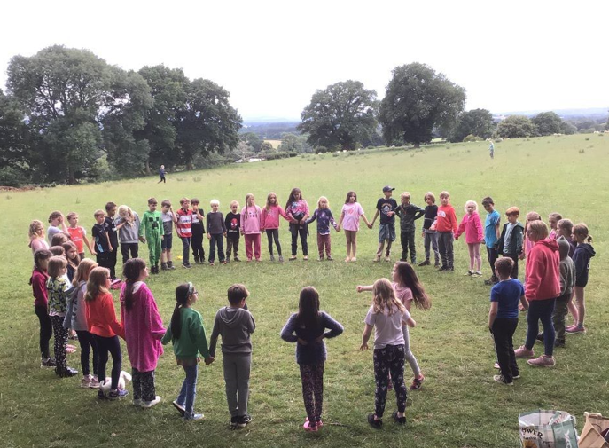
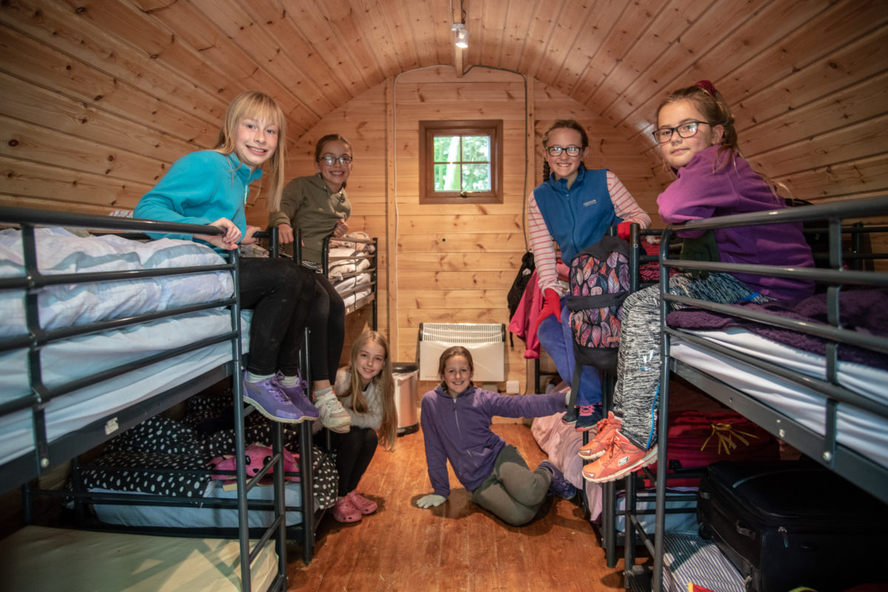

Slide 6
What’s different?
National Multiplication Tables Check (MTC)
The multiplication tables check is an online, on-screen assessment given to pupils in year 4. It checks their ability to fluently recall times tables up to 12x12.
All eligible year 4 pupils who are registered at state funded schools including academies and free schools and special schools in England are required to take the check.
It’s made up of 25 times tables questions. Your child will be able to answer 3 practice questions before taking the actual check. They will then have 6 seconds to answer each question. On average, the check should take no longer than 5 minutes to complete. Source: Gov.uk
[See separate leaflet]

Slide 7
What’s different?
National Multiplication Tables Check (MTC)
Is this test stressful?
Many children last year didn’t even realise they’d done it! Their confidence came from practice. Children have been learning their tables in a structured way since Y1.
The key part in Y4 is to build their fluency (as well as adding in the remaining few tables).
We do this through a variety of interactive ways, including:
learning a fact a day
regular TimesTable Rockstars – both at school and home (7 mins a day is recommended).
learning tables by rote
singing songs (see web page).

Slide 8
Classroom Routines
At the start of the day, children are responsible for:
placing lunch boxes neatly on the cloakroom shelf.
hanging bags and coats on their pegs. NO rucksacks please, there is no room for them on the pegs.
handing in any letters/reply slips/money.
putting book bags in their trays in the classroom, so please keep them free from clutter – otherwise they just don’t fit! All children would benefit from a book bag as it enables a clear communication with home. (Please ask if there’s a problem.)
changing their reading/library books.

Slide 9
Classroom Routines
Water bottles in classroom boxes – water only in the classroom please. (NB we will be investigating the effect of sipping acidic/sugary liquids on our teeth in Science this term.) Squash/fruit juice is fine for breaktime and lunch.
Lunchtime – morning lessons end at 12:10pm. The children go outside for a quick run around before lunch. Please note, many children get hungry by this time so a healthy snack (fruit or veg) for morning break is much appreciated.
Water bottles stay in school all week, but go home Friday for a good wash.

Slide 10
Behaviour Expectations
“Be ready! Be respectful! Be safe!” – school rules
“Try your best!” – class rule
School behaviour policy
Class charter
House points and rewards
Champion certificates – for achievement, effort and attitude
Honesty – if you’ve made a mistake own it and learn from it!

Slide 11
Uniform Expectations
Please ensure all uniform is labelled…with your child’s name!
Indoor PE – white t-shirt, burgundy shorts
Outdoor PE – white t-shirt, burgundy shorts, a change of socks and trainers.
Cold weather – black, grey or navy joggers, with school sweatshirt or hoodie (For hockey – Autumn 1 - shin pads with long socks are highly recommended.)
We aim to get outside if at all possible, so please ensure your child has warm options and a change of socks!
Safety: long hair must be tied up, earrings removed or taped, watches removed

Slide 12
The Curriculum
National Curriculum (2014)
Skills-based curriculum taught through termly topics
    Daily Maths and English
    Weekly Science

Slide 13

Maths
In school
Focus on mental maths strategies and real life problem solving
Spiral curriculum revisiting topics, particularly key numeracy operations (Following the White Rose scheme)
Fluent in 5 – daily recap sessions to develop fluency
Times Tables – recapping 2, 5, 10s (Y2) and 3, 4 and 8s (Y3) as well as learning 6, 7, 9, 11 and 12s.
At Home
Practise tables frequently, in a variety of ways, to develop instant recall.
Use maths in real life contexts, e.g. time, money, measurements

Slide 14
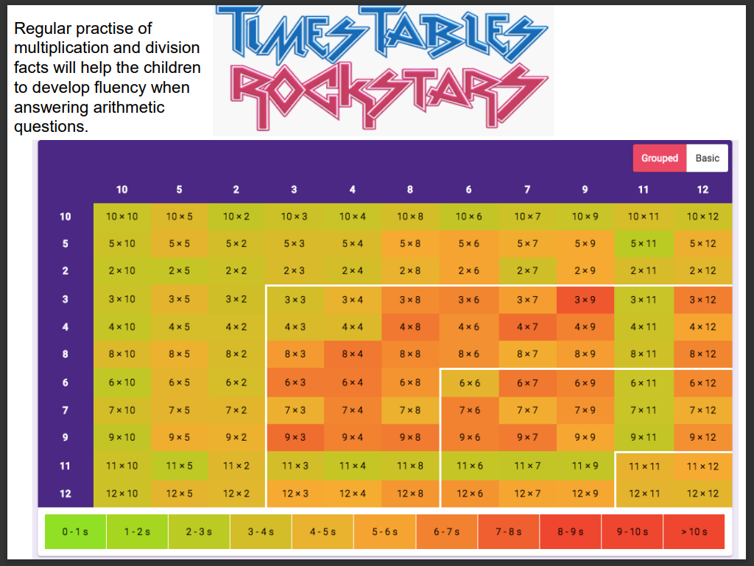

Slide 15


English
In school
Speaking and listening (incl. weekly drama lessons)
Reading
Writing
Handwriting
Spellings – weekly lists, practised daily
At Home
Practise weekly spellings: use Edshed (and/or ‘Look, say, cover, write, check sheets).
Reading – please continue to read to and listen to your child read. Please don’t be tempted to stop because they can read independently, they still need to develop their vocabulary, expression and understanding. Audio books can be a good option too for introducing a wider writing style and richer vocabulary.

Slide 16

Small Group Work
At some point in the year, your child might have the opportunity to participate in a small group session aimed at supporting their academic or social development.
This may be a one off but is more usually on a 6 weekly basis.

Slide 17
Homework
Our home-school partnership is so valuable to your child. Homework gives an opportunity for them to embed their learning, by extra 1:1 practice.
Homework is due in every Wednesday.
Reading – daily is best, make it part of your child’s routine
Spellings –test on Friday – EdShed is a fun way to learn
TTRockstars – 5 mins, 5 times per week. There will be certificates and challenges to win.
My Maths – fortnightly
One other piece of homework should be selected from the options given. Handwritten, typed, video, photographs, PPT – it’s not intended to be a battle.

Slide 18
Working together
Support your child to establish routines around homework, reading and uniform.
Enjoy our class web page. We will add photos regularly, but your child may also be inspired by looking at those from previous years.
Keep in touch: Oxenhall@gorsleygoffs.hereford.sch.uk
Volunteers welcome
Do you have regular time to listen to readers?
Do you have time to support occasional activities?
Do you have a particular skill that would enhance our learning?

Slide 19
Thank you!

