Slide 1
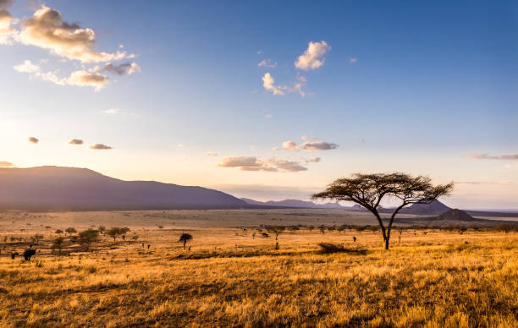
SAVANNAH
BY BONNIE AND HARRIET

Slide 2
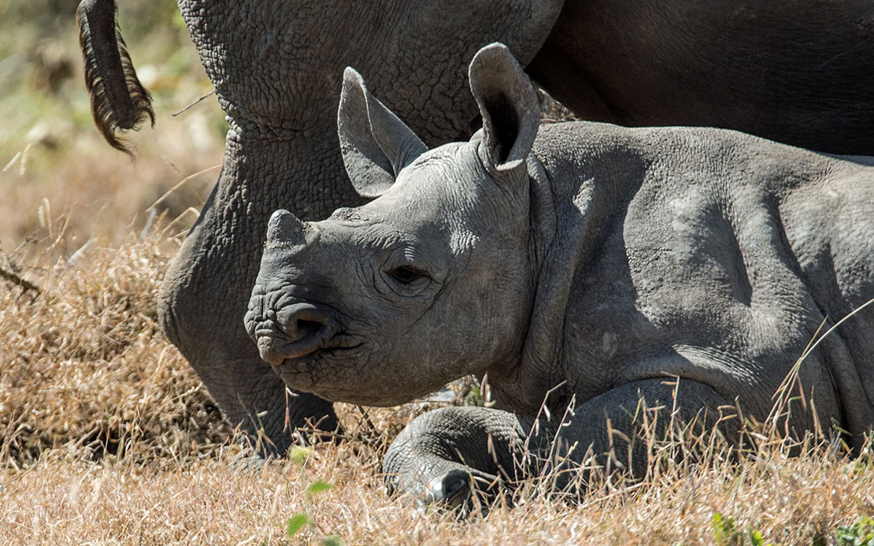
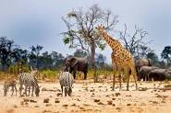
Animals
The black rhino
Leopard
African elephant
Cheetah
Ostrich
Zebra
Wildebeest
Tiger
Lions
Giraffes
Prairie dogs
Hyenas

Slide 3
Flora and Fauna
The animals of the savannah are often grazing herbivores. They migrate to move with the wet season, following the rain, which increases the diversity and quantity of vegetation.
Coverage
Approximaltely 17 percent of the Earths terrestrial environment.
The area can go up to 25,000 square kilometers.

Slide 4
Climate
Rainy and dry seasons-Savannahs have two distinct seasons in regards to precipitation . There is a rainy season in the summer with around 15 to 25 inches of rain and a dry season in the winter when only a couple of inches of rain may fall.
Warm-The savannah stays pretty warm all year . It cools down some during the dry season, but stays warm and humid during the rainy season.

Slide 5
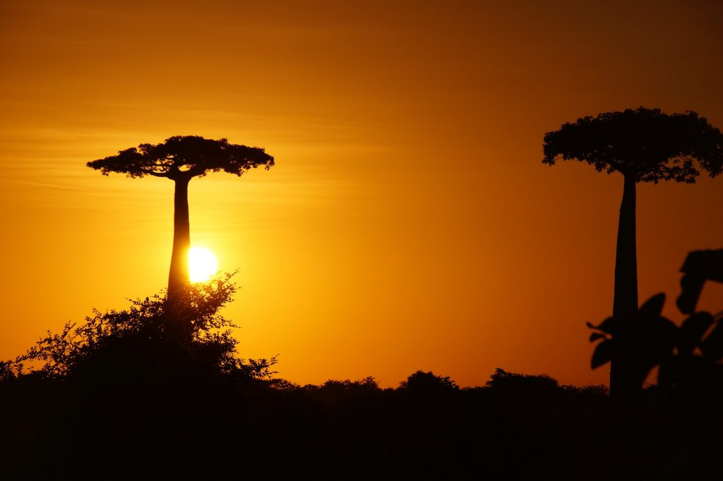
Plants
The majority of the savannah id covered in different types of grasses including lemon grass, Rhodes grass, star grass and Bermuda grass . There are also lots of trees scattered about the savannah . Some of thee trees include the acacia tree, the baobab tree, and the jackalberry tree.
The plants need to be able to survive the dry season and drought in savannah . Some store water and energy in their roots, bulbs, or trunks . Others have roots that go deep into the ground to reach the low water table.

Slide 6
Importance to the earth
It homes our beautiful animals like Giraffes,Hyeans,Black rhino and lots more.
It also has lots of nice trees and plants mentioned on our plants page.

Slide 7
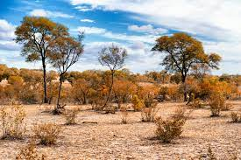
Location
Grasslands are generally located between deserts and forests . The major temperate savannahs are located in central North America I the United States, in Southeast South America in Uruguay and Argentina, and in Asia along the southern portion of Russia and Mongolia.

Slide 8
Did you know
The Serengeti is home to Africa’s largest ostrich population .
The African savanah is populated by more herbivores than carnivores, due to the wide availiability of grasses.

