Slide 1
NEWENT ANGLO-SAXONS
By Arthur Lovegrove.

Slide 2
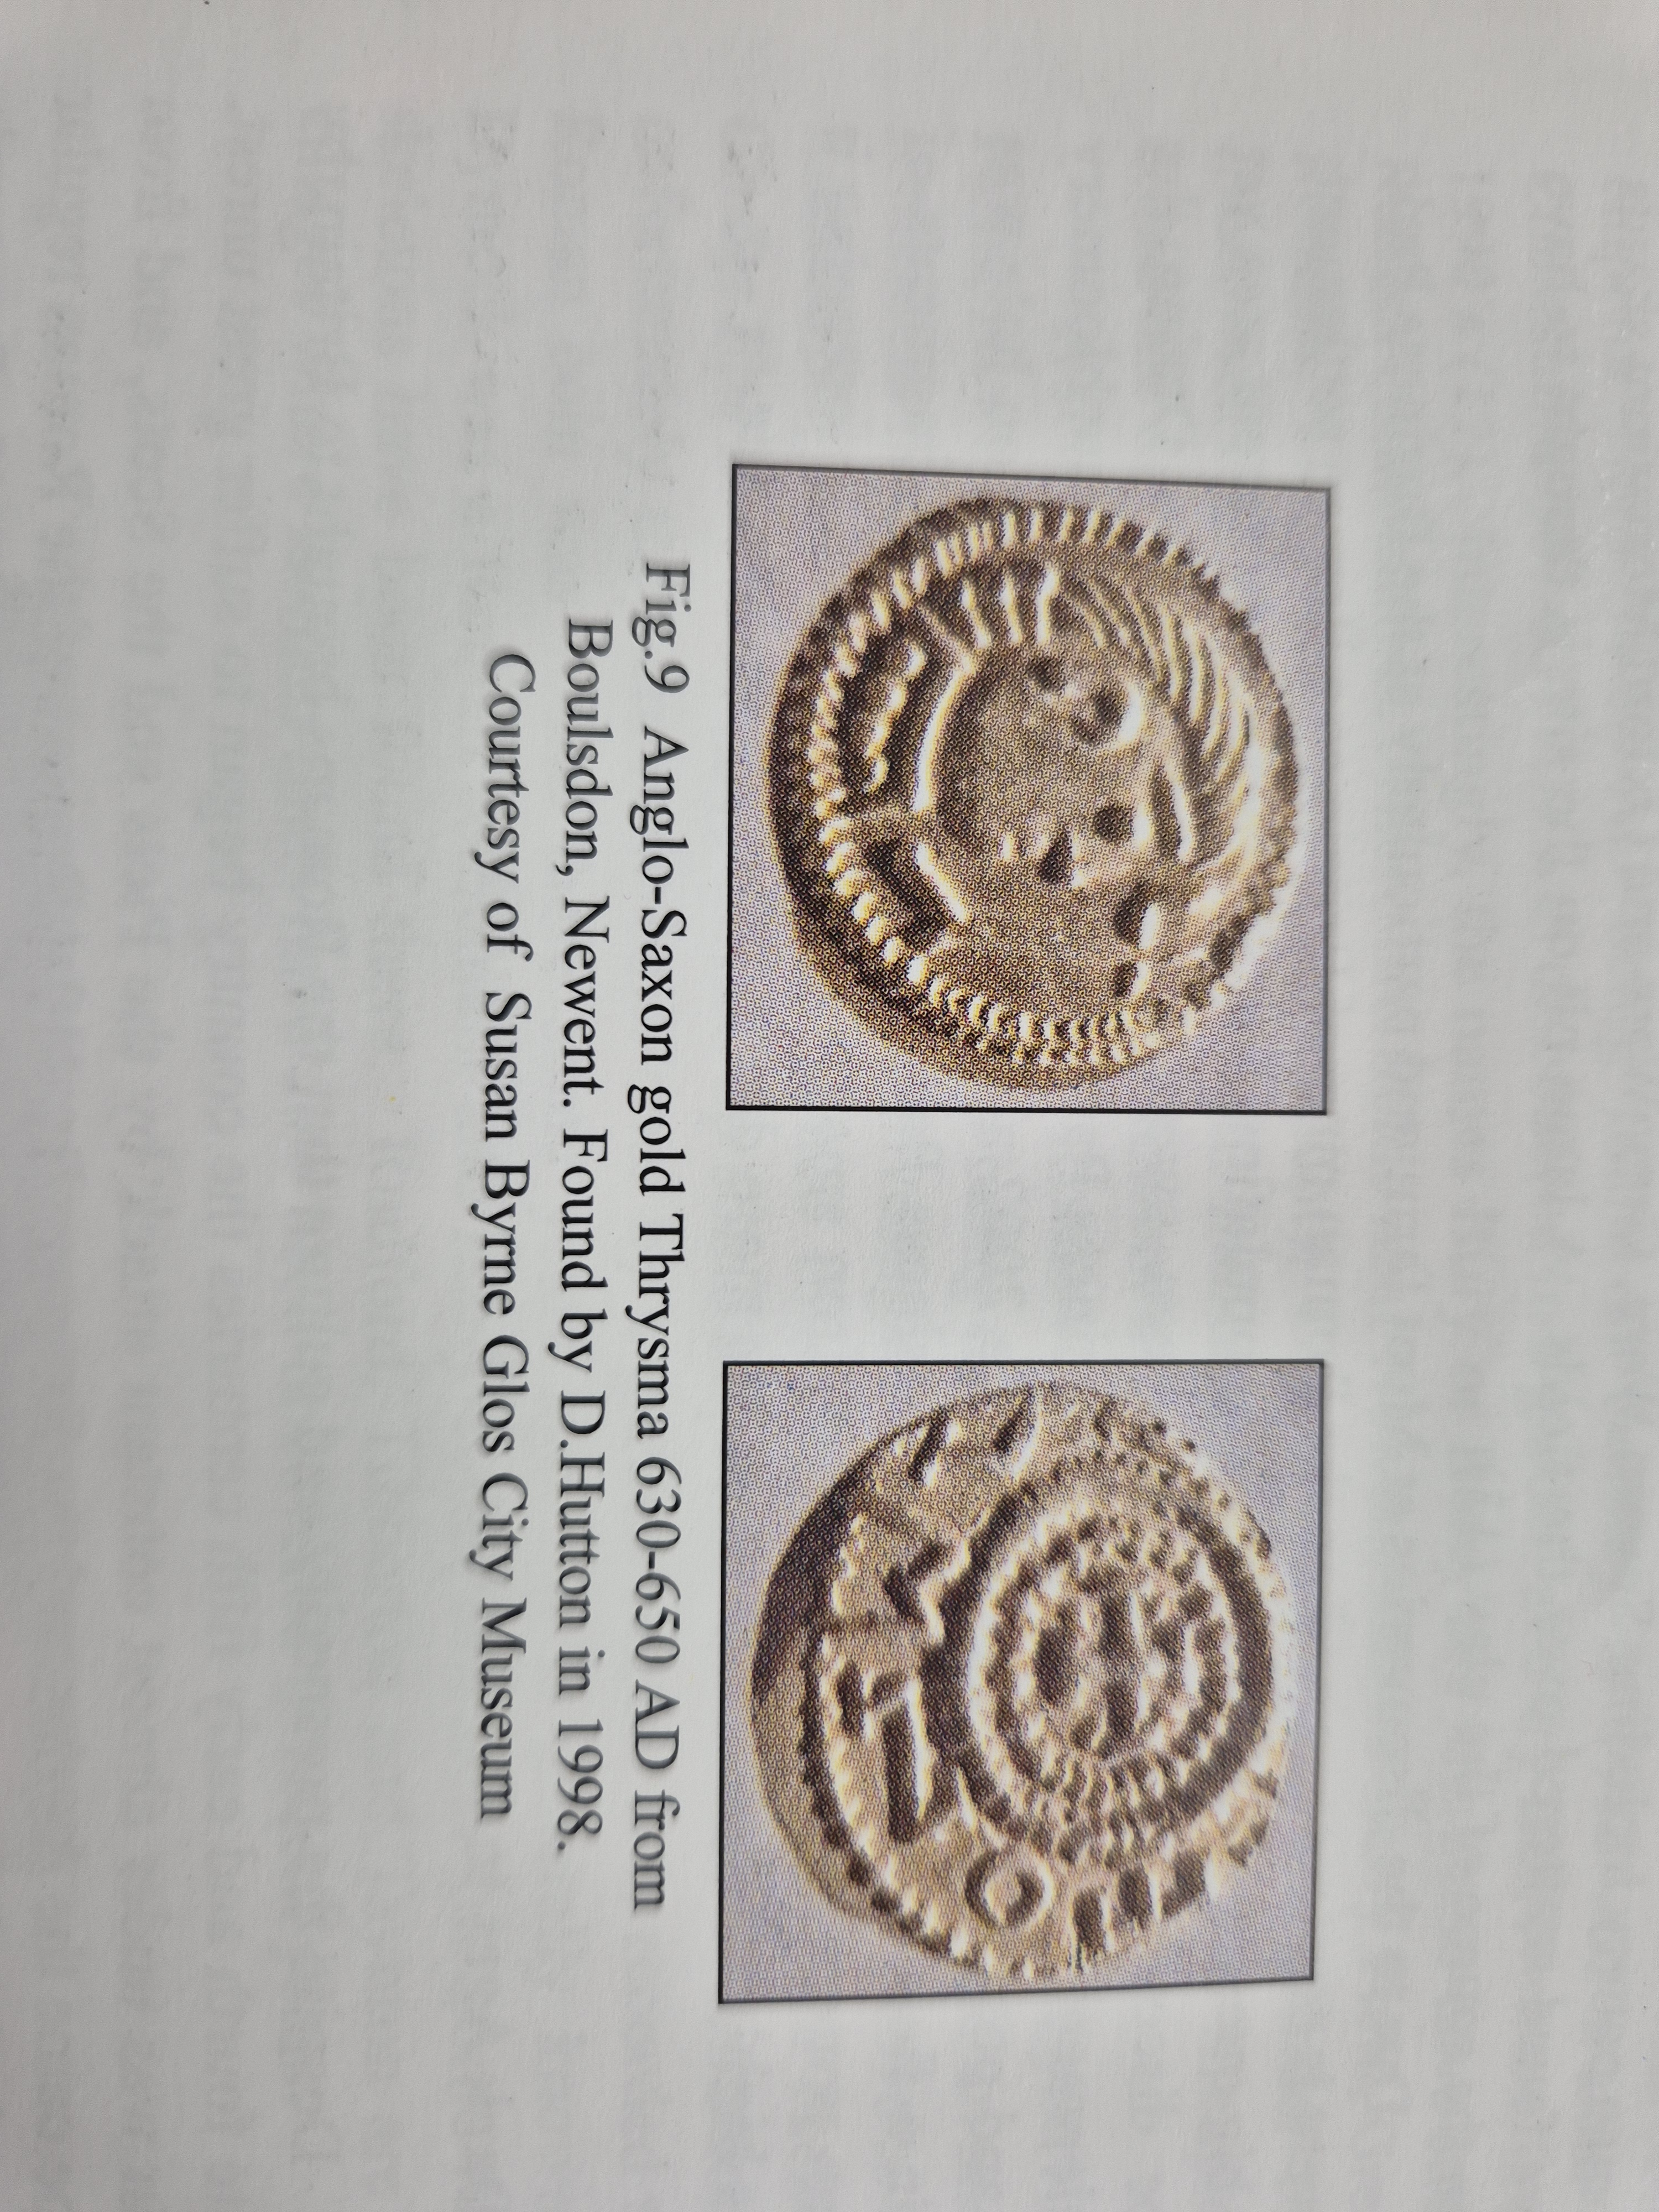
What money did Anglo-Saxons have in Newent?
These are Anglo-Saxon coins found in Newent, called gold Thrysma.

Slide 3
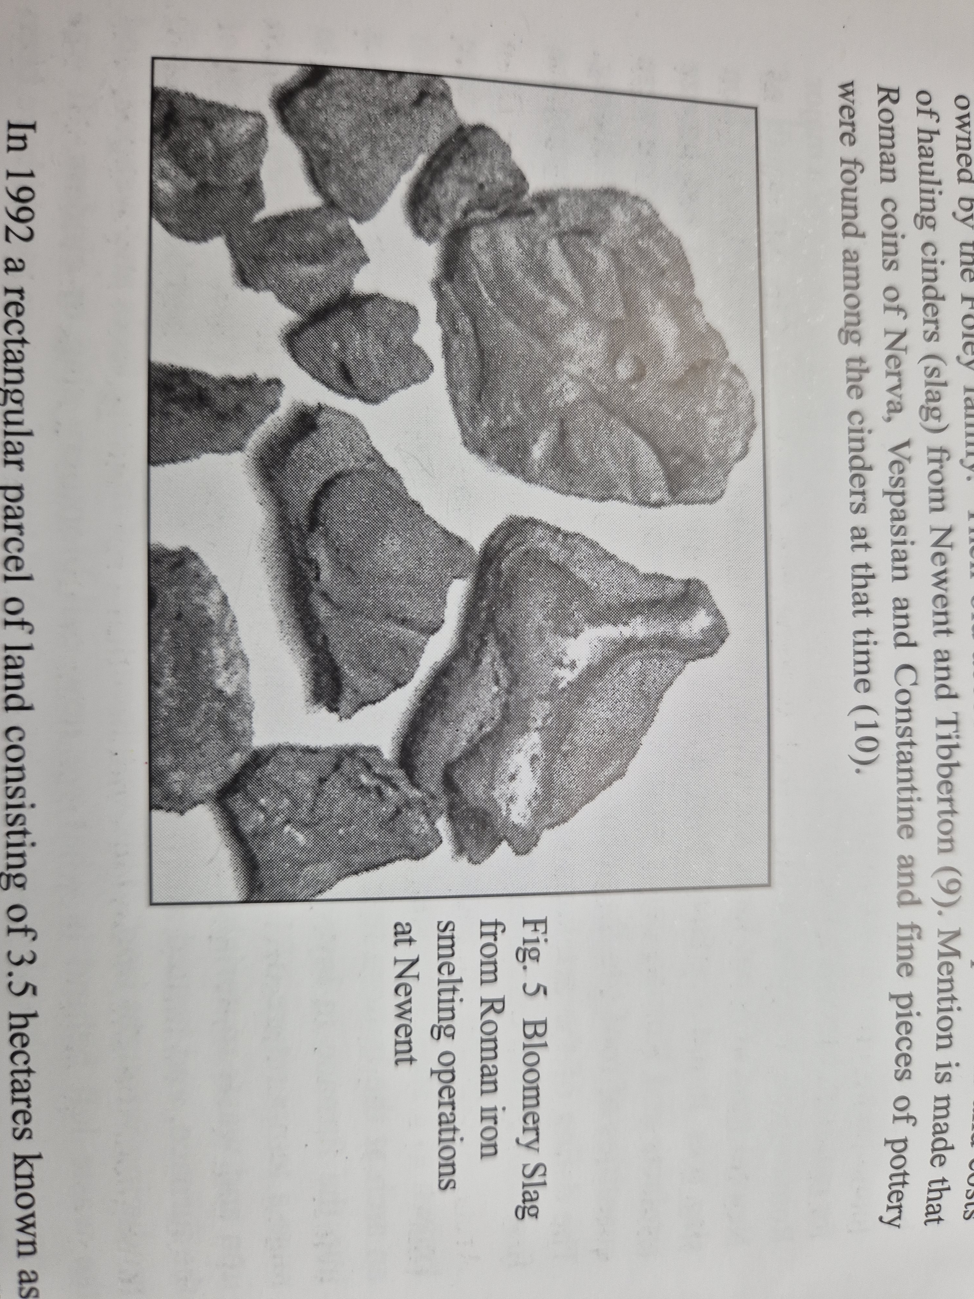
What smelting did Anglo-Saxons do in Newent?
Anglo-Saxons smelted iron to make axes.
The iron and coal came from mines and caves in the Forest of Dean.

Slide 4
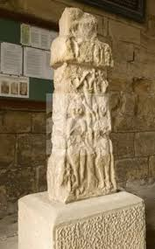
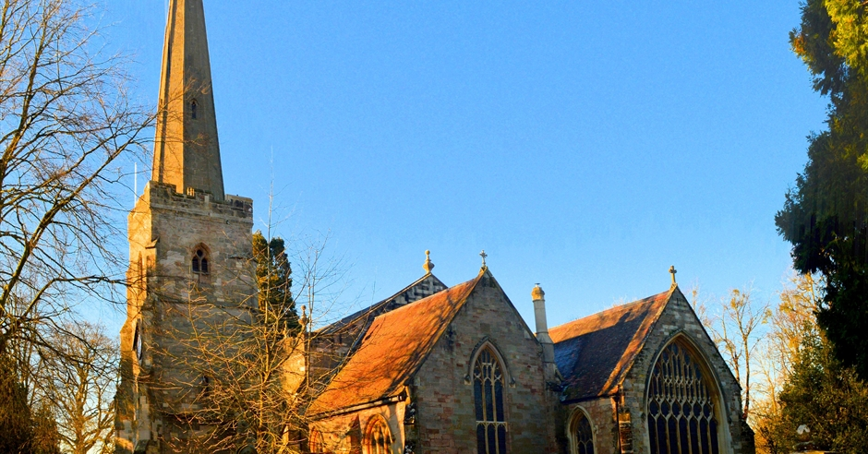
Where did Anglo-Saxons bury people in Newent?
Anglo-Saxons in Newent buried people at St Marys Church. But the church was not there. It was just a burial ground.

Slide 5
Quiz
Q1. Where did Anglo-Saxons bury people in Newent?
Q2. What money did Anglo-Saxons have in Newent?
Q3. What did Anglo-Saxons smelt in Newent?
Q4. Where did the resources come from?

Slide 6
Answers
A1. St. Marys church
A2. Gold Thrysma
A3. Iron using coal
A4. Mines and caves in the Forest of Dean

Slide 7
Thank you for listening

