Slide 1
Introduction to photography
BY OLIVER GRAY

Slide 2
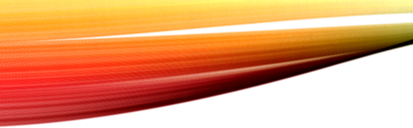
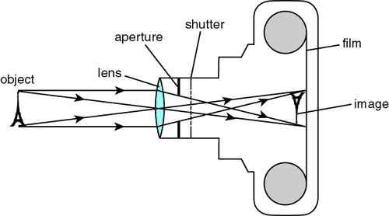

HOW A CAMERA WORKS
Light from an object is reflected into a lens.
The light travels through a hole called an aperture.
A shutter controls the amount of time the light is aloud to enter.
The light is recorded on a sensor or film. This is the photo image.

Slide 3
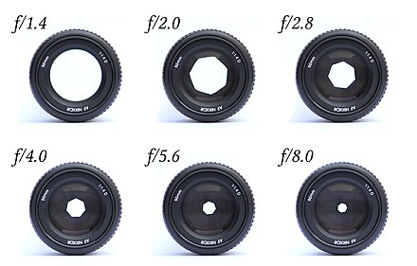
Aperture
Big apertures are used at night, for sports and portraits.
With a big aperture only things close by are in focus.
Small aperture is used for landscapes.
With a small aperture everything is in focus/detail.

Slide 4
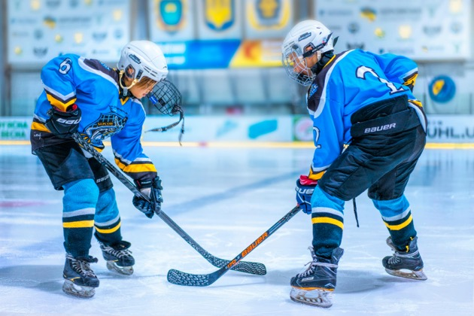
Big Aperture
Players in detail.
Blurry background.

Slide 5
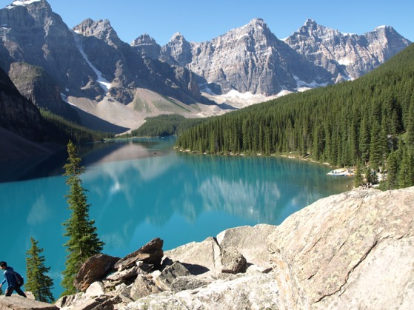
SMAll Aperture
Good for landscapes
Lots of detail

Slide 6
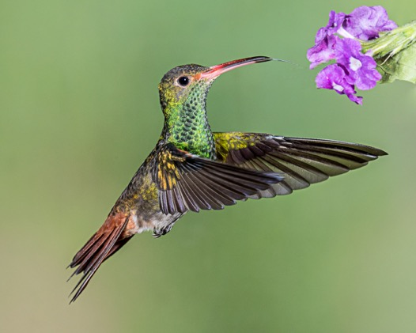
Fast Shutter Speed
If you want to take a picture of something moving quickly you need a fast shutter speed.

Slide 7
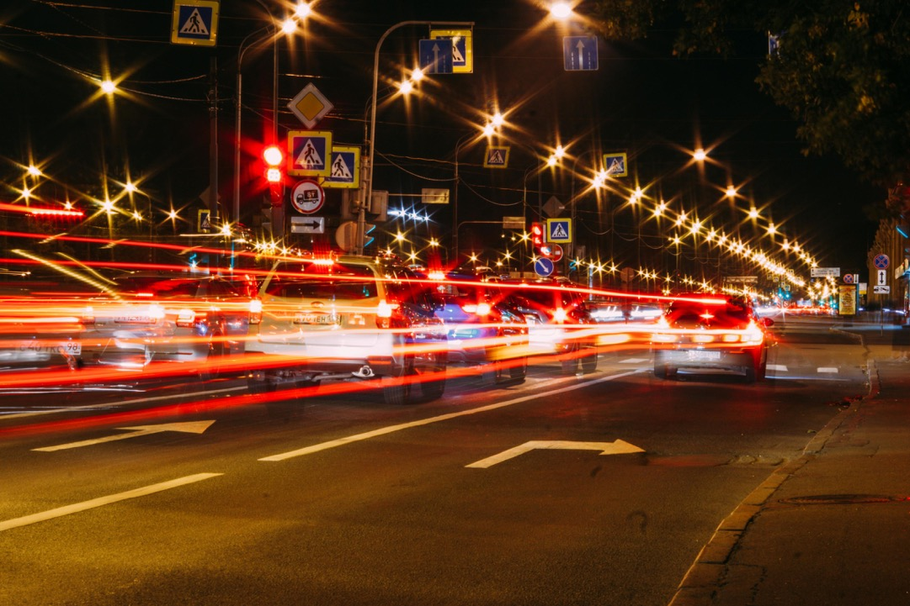
Slow Shutter Speed
When there is less light you will need a slower shutter speed.
There are cool tricks you can do with slow shutter speeds

