Slide 1
Venus
By Harriet, Jack, Charlie and Emily

Slide 2
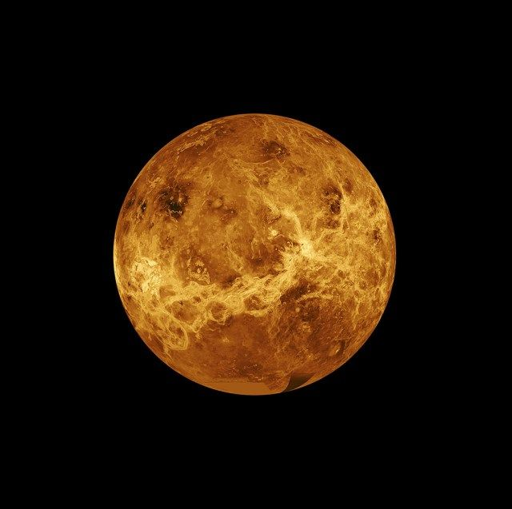
Facts about Venus
Venus is often mistaken for a star because after the moon it is the brightest object in the night sky.
Venus was discovered in 1,700 BC by someone called Babylonian astronomers.
It has a thick atmosphere full of the greenhouse gas carbon dioxide and clouds made of sulfuric acid.

Slide 3
Venus datafile
Diameter 12,104 km
Mass 0.82 x Earth
Density 5.2 [water = 1 ]
Minimum distance from sun 108 million km
Maximum distance from sun 109 million km
Minimum distance from Earth 42 million km
Day and Night 117 Earth days
Length of year 225 Earth Days
Tilt of axis 12 42

Slide 4
Interesting Facts
It is possible that you could survive in the Venusian atmosphere
Venus has no moons
The reason why none has visited Venus is because its carbon dioxide rich atmosphere is 90 times as dence as ours and surface temperature average 800 degrees Fahrenheit
Venus rotates the opposite way to the Earth [anticlockwise].
Made of rock temperature 462 degrees.

Slide 5
Thanks for reading!

