Slide 1
Uranus
By Joe, Mabel, Poppy and William

Slide 2
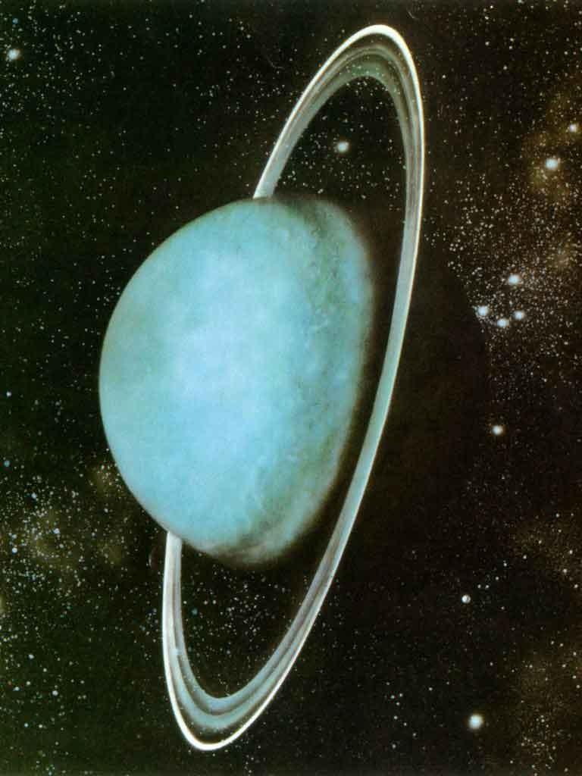
What is Uranus made of?
Uranus is made of water, methane ammonia . Most(80% or more)of Uranus’ mass is made up of a hot dense fluid of “icy” materials.

Slide 3
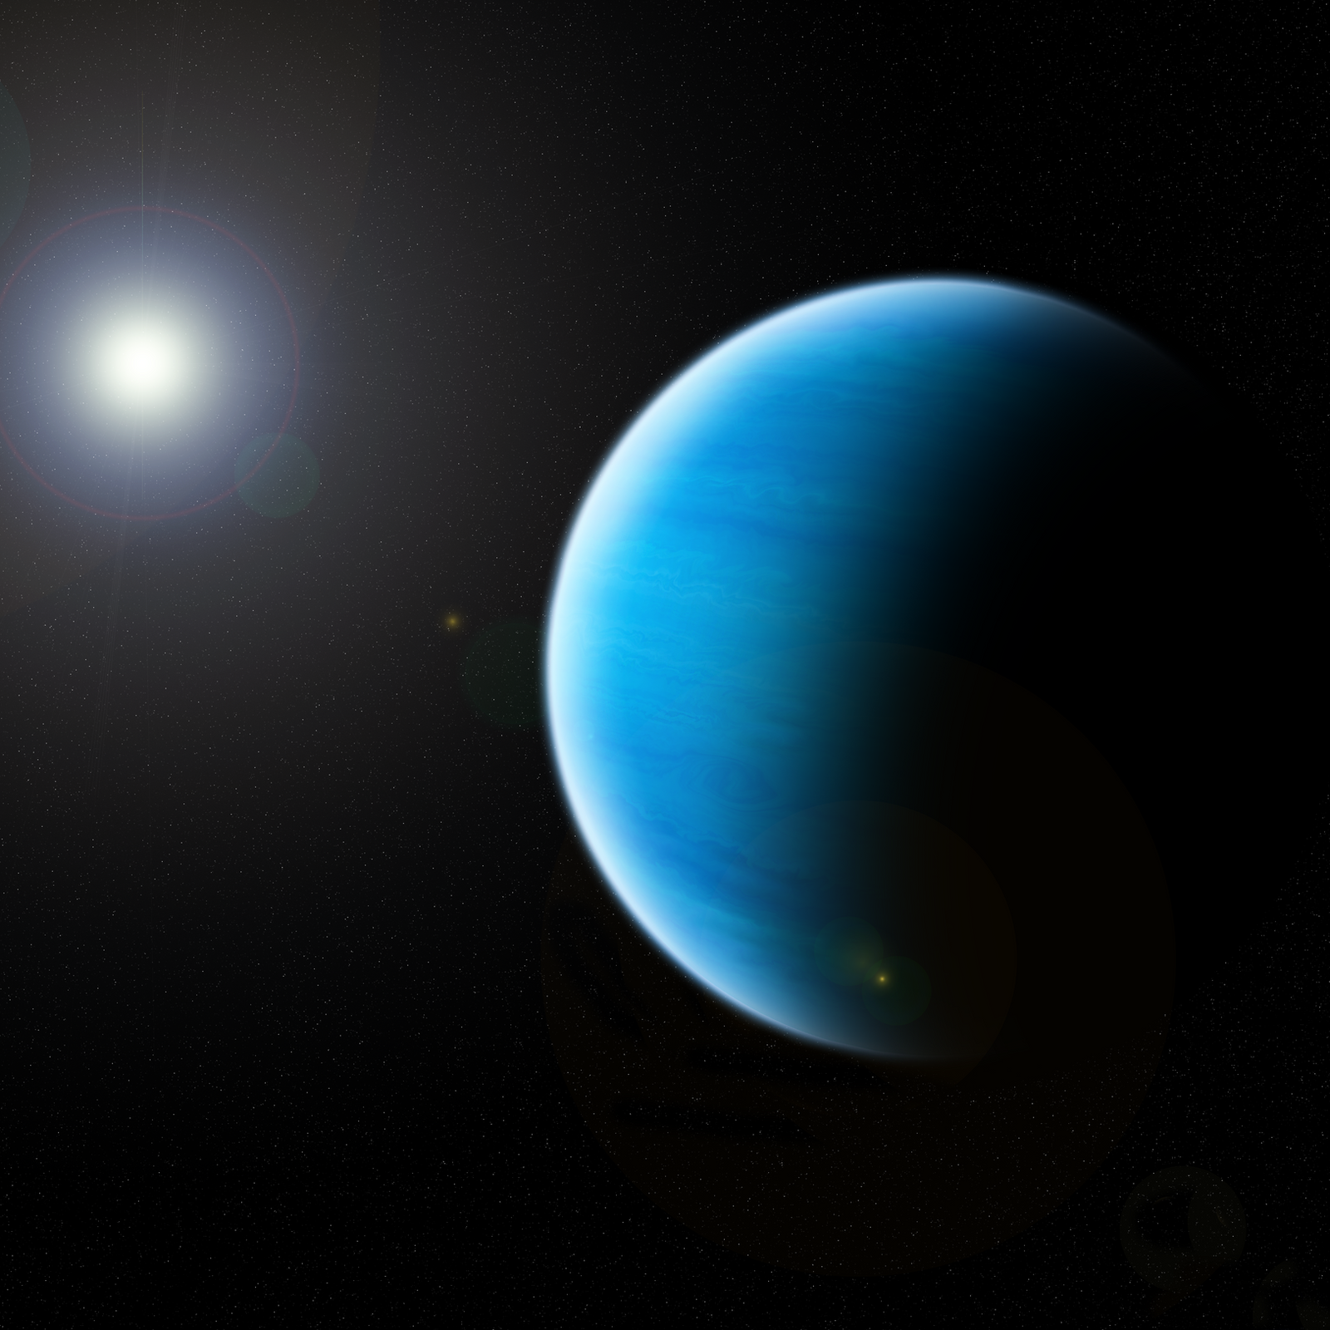
Fun facts about Uranus.
Uranus is the 7th planet from the sun.
Uranus can fit 63 earths in it
Uranus has 13 rings
Uranus is 31,518 miles wide!
Uranus makes 1 trip around the sun every 84 Earth years!
Uranus has 27 moons including Titania , Umbriel and Trinculo.

Slide 4
How cold is Uranus?
Uranus is very cold at a freezing -197 degrees!
Uranus is 2.877 Billion Km away from the sun , that’s insane!
Uranus is tilted 98 degrees so it rotates in the opposite direction to the other planets in the solar system.
Uranus is named after the Greek god of the sky.
There are 30687 days in a Uranus year

Slide 5
What does Uranus look like?
Uranus is a blue-green color that is similar to turqoiuse.
Sunlight passes through the atmosphere and is reflected back out by Uranus’ cloud tops

