Slide 1
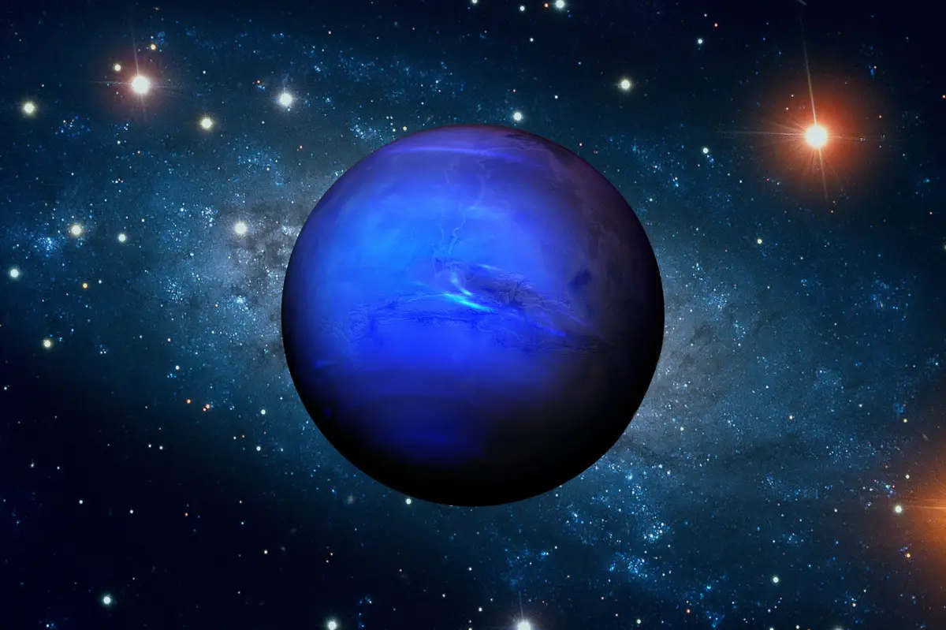
This is Neptune
By Olivia, Bella, Woody and Ted

Slide 2
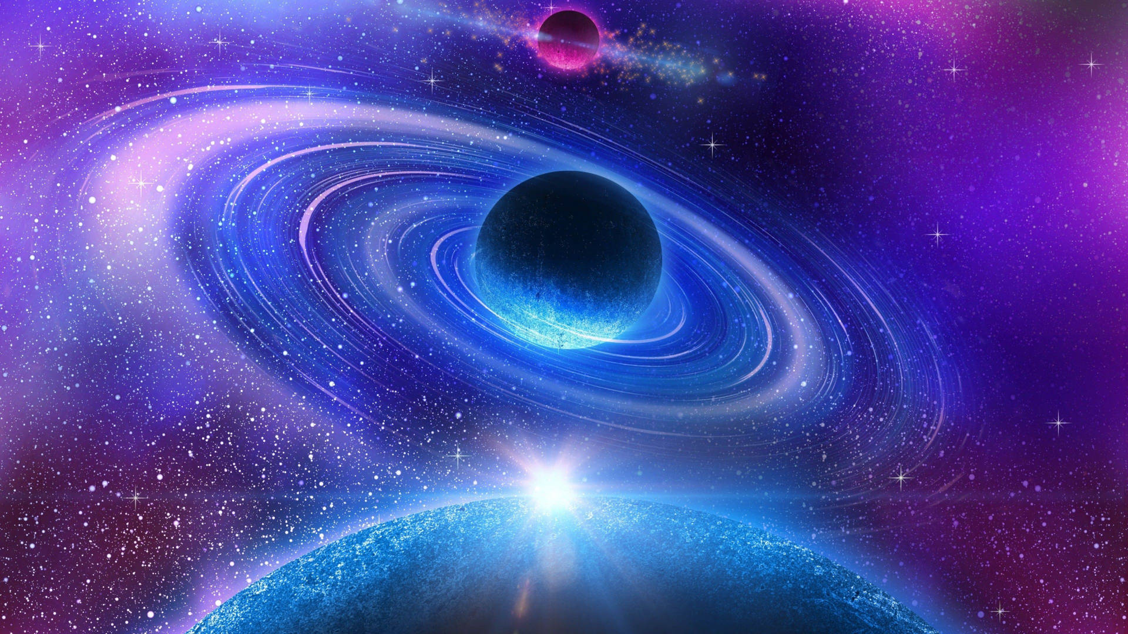
All about Neptune
Neptune is encircled by 6 rings.
1 day on Neptune is 16 Earth hours.
There are 60,190 Earth days in a Neptune year.
Neptune has 14 moons.
Neptune is the 8th planet from the Sun.

Slide 3
Neptune’s Appearance
Neptune is light blue because it is an ice giant.
The great dark spot was the name of the storm on Neptune that lasted 5 Earth years.
The temperature on Neptune can get up to -210 degrees Celsius.

Slide 4
Discovering Neptune
Neptune was discovered on the 23rd September 1846
Neptune was discovered by urbain le verrier and Johann galle

Slide 5
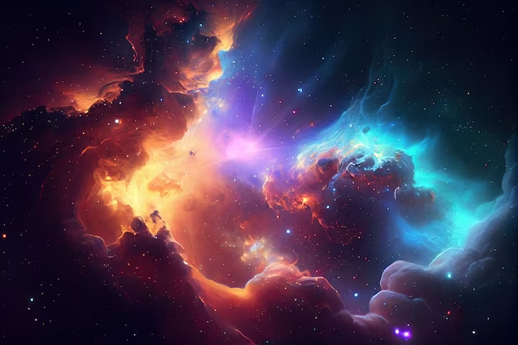
Thanks for watching
bye

