Slide 1
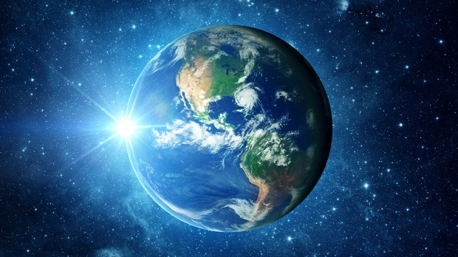
PLANET EARTH
By HUDSON AVA MALI ASHTON ELIZA.

Slide 2
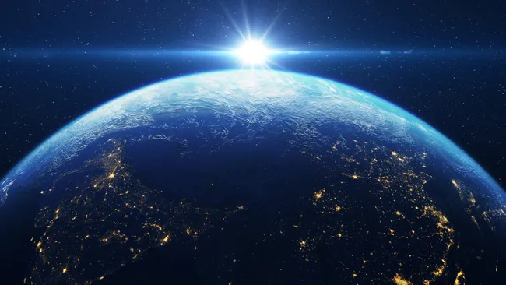
Facts About Earth
The Earth is made of rock and metal and the Earth has one moon . The Earth holds about 71 percent of water but you will never know the exact estimate The Earth is green blue white and the temperature is about -88.c venus is the neighobouring planet

Slide 3
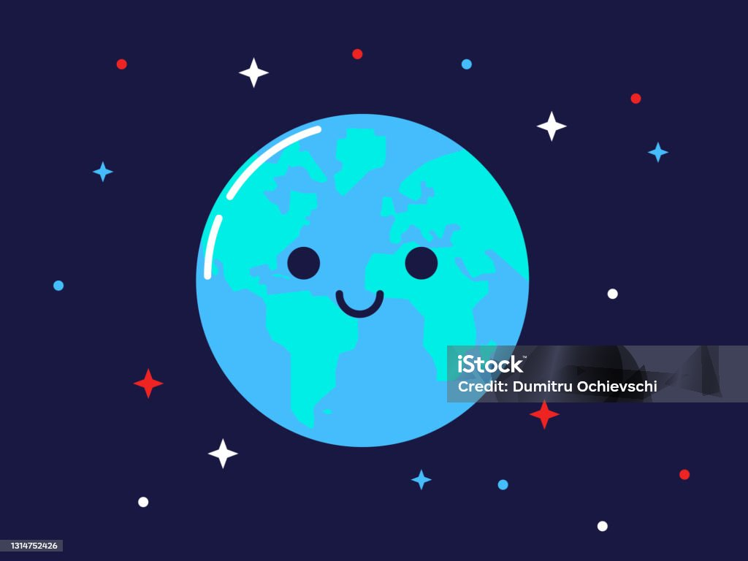
FUN FACTS!!!
Are home planet is the only planet in the solar system to have liquid water on the service therefor there is life

Slide 4
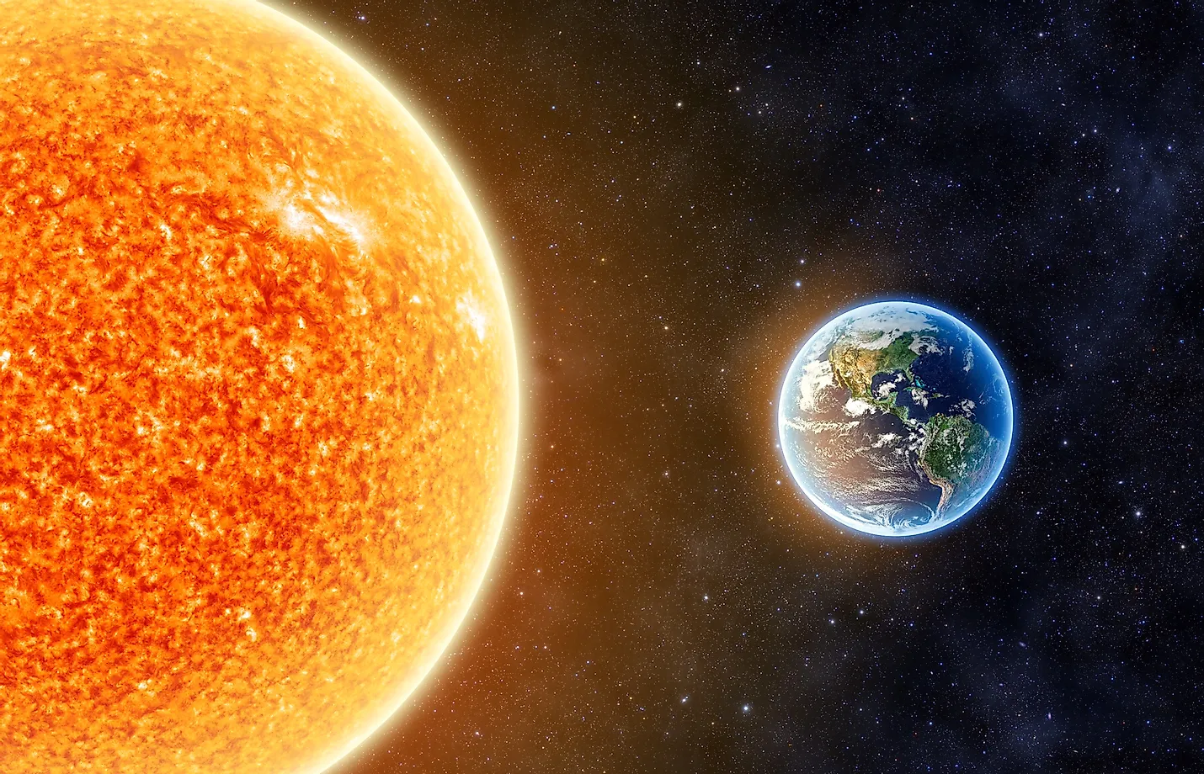
Fact about sun!!!!!!!!
The Earth is 149.5 million km from the sun and the third planet from the sun. it takes 365.25 days to orbit the sun

Slide 5
GOOD BYE WE HOPED YOU ENJOYED ARE SUN AND EARTH FACTS!!!!!!!!!!!

