Slide 1
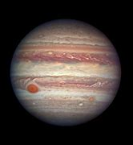
JUPITER
By Edward,Daisy,Harri and Mia
GAS GIANT

Slide 2
Appearance
Jupiter is white , orange,red,brown and yellow. It looks like marble but it is gas.
A part of Jupiter’s surface is a spot ,actually a storm that has been raging for centuries. Earth could fit into it!
Jupiter is the biggest in the solar system

Slide 3
Surface
The planet is made of gas.
The surface has a lot of coulured stripes!

Slide 4
Temperature
Distance from the
sun
The temperature is -87 degrees celcius to -5 degrees celcius .
Jupiter is 778.5 km from the Sun
Time it takes to orbit the Sun
Jupiter has 95 moons
4332 days

